Slide 1
FINTECH HACKATHON Bank Marketing PROBLEM

Slide 2
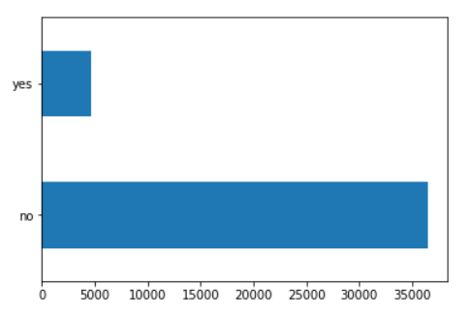
Step 0: Define Evaluation Metric
Metric to evaluate results was determined by distribution of target variable
Given the skewness of the target variable, we chose AUC of ROC to be our evaluation metric

Slide 3
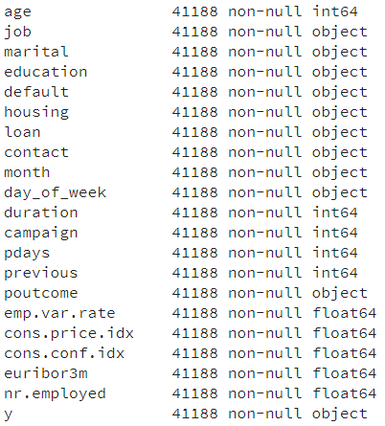
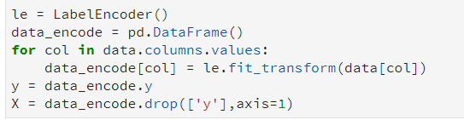
Step 1: Exploratory Data Analysis
Shotgun Approach
Columns
Label Encode
Target variable: subscribed (yes/no) to a term deposit

Slide 4
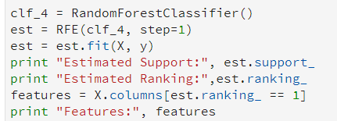
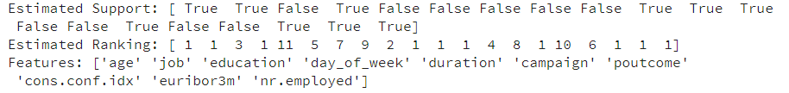
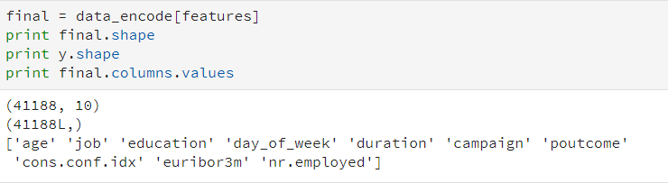
Step 1: Exploratory Data Analysis
Drop Less Important Columns
1
2
3

Slide 5
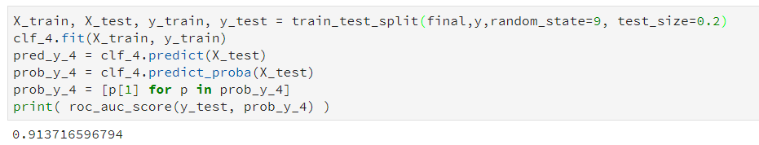
Step 3: Split data & predict
AUC of 91% was emerging because ‘Duration’ of the call was highly influential in how likely a person was going to subscribe.
We decided to delete this from our model because new data points will not have calls and therefore no call ‘Duration’
After removing duration, our AUC dropped to

Slide 6
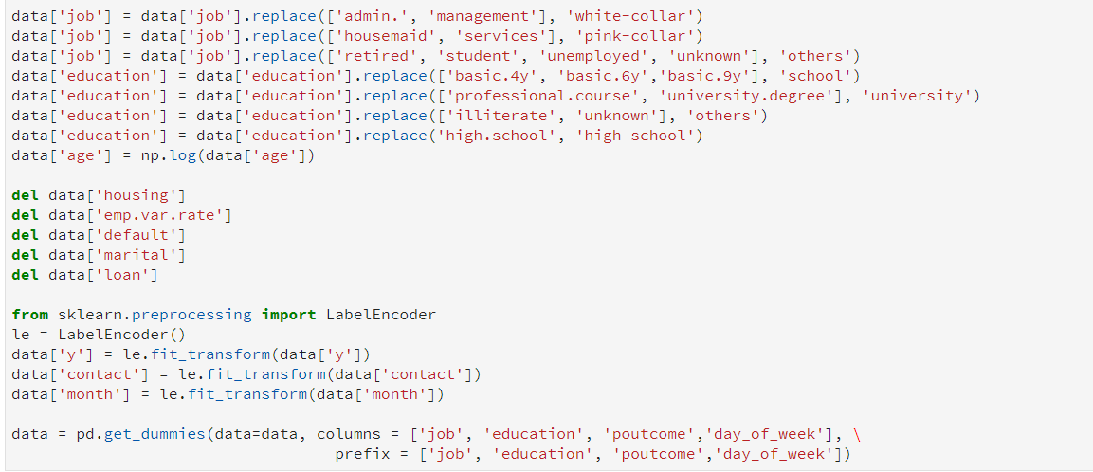
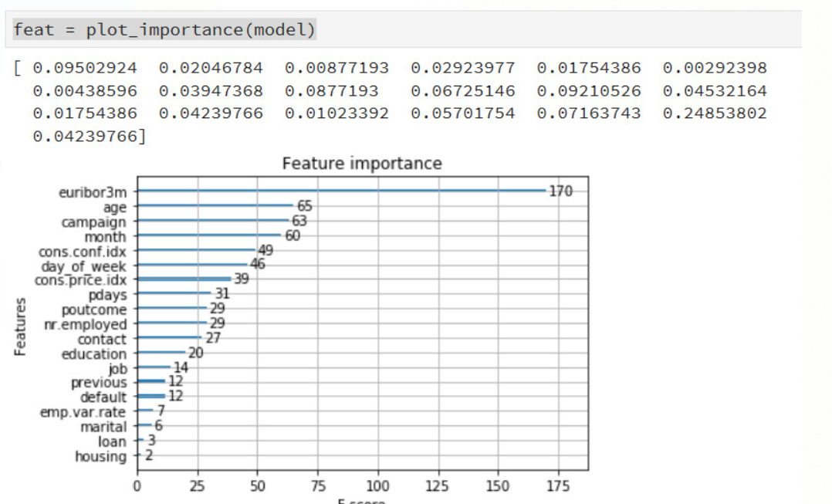
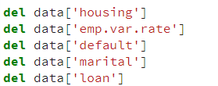
Step 4: Reformat Data
Label Encoding and One Hot Encoding of variables
1
Delete the lowest 4 predictive features
2
3

Slide 7
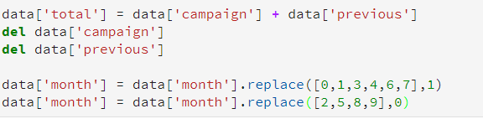
Step 5: Treatment of Data
Merged ‘Campaign’ and ‘Previous’ into one column to give an overall indication of how long a person has been contacted in the past
Encoded months to be binary due to skewness of number of calls made in each month and % of subscribers

Slide 8
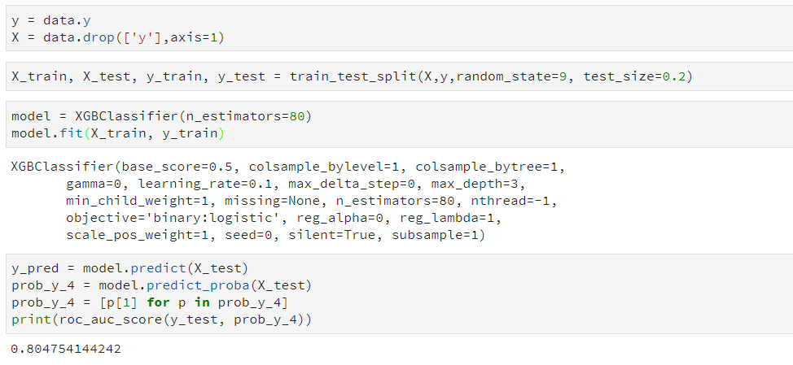
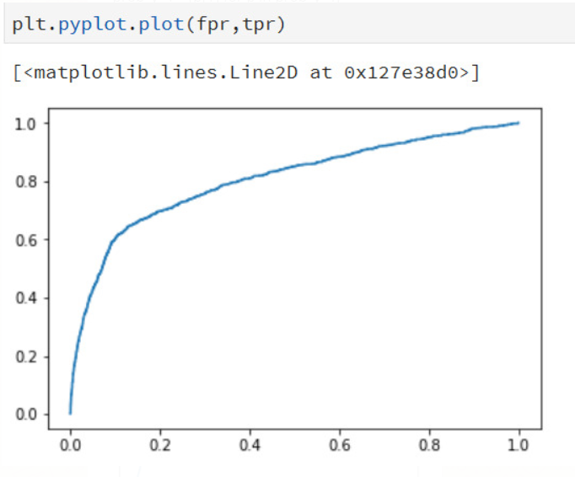
Step 6: Split, fit & run

Slide 9
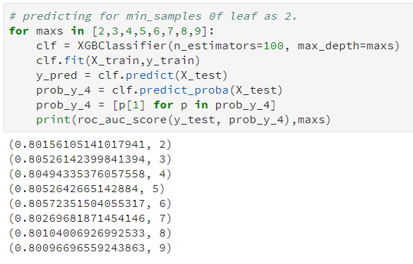
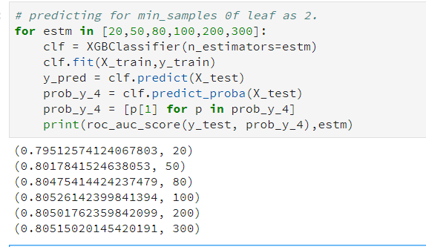
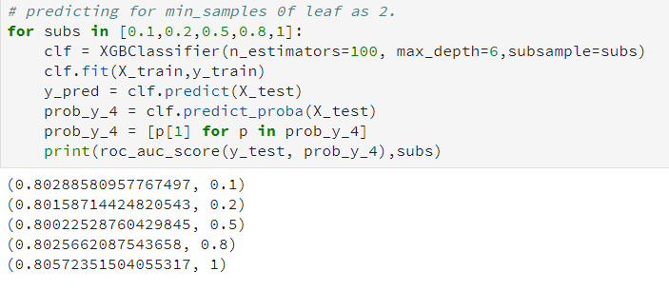
Further Steps & Evaluation
Parameter Tuning
1
2
Also tried to implement ‘Stacking’ however AUC was only coming out to be 64%
3

